Slide 1



LEARN NEW
Spreading knowledge in a fun way!
Actions on Google

Slide 2
|
WHY ?
|

Slide 3
150 years ago
Now

Slide 4
150 years ago
Now

Slide 5
|
|
But it is up to us how we shape the future.
Actions on Google

Slide 6
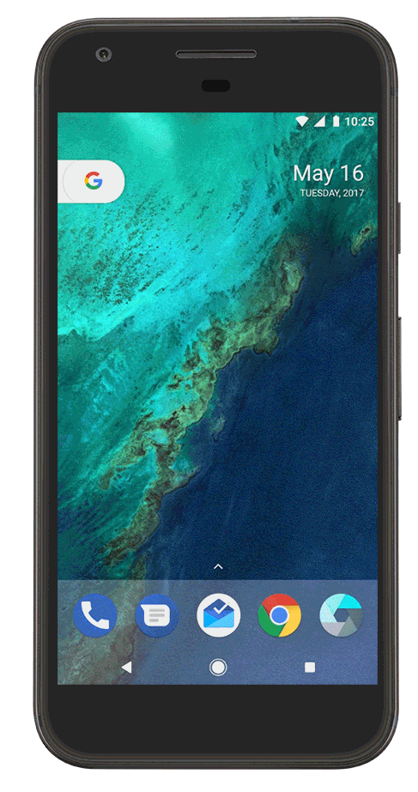



Customized Education
Customized Education
What do you need then ?
Actions on Google

Slide 7
|
HOW ?
|
Actions on Google

Slide 8
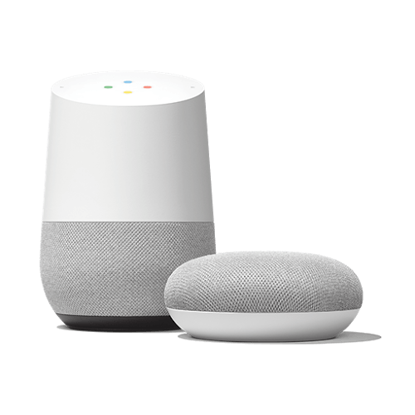


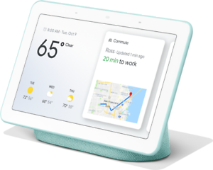
CONVERSATION
AL
UI
Actions on Google

Slide 9

1B+
30
Language Support
Devices
Google Assistant
Actions on Google

Slide 10
|
WHAT ?
|

Slide 11
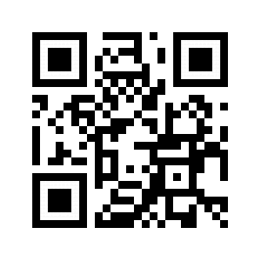
The Learn New Action on Google
DEMO?
bit.ly/1023-mb
Sure.

Slide 12

THANK YOU !!
Amrit Dash
Manish Rath
about.me/amritdash
about.me/manishrath

